Slide 1
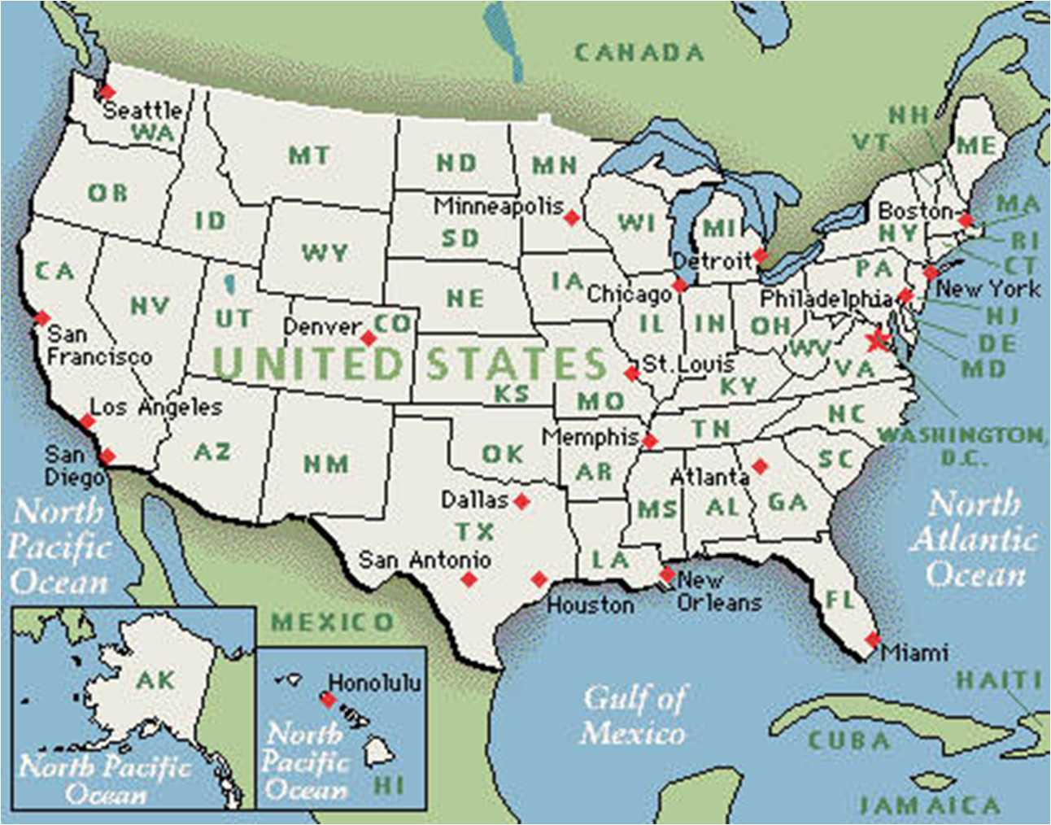

Map It Out!
Understanding and Using Maps
By E. I. See

Slide 2
Table of Contents
What is a Map……………………….p. 4
Using a Map ………………………….p. 5
Map of a Community …………….p. 6
Understanding a Map ………..….p. 7
Map of a State ………………………p. 8
Map of a Country ………………….p. 9
Map of the World ………………….p. 10
Maps of Long Ago ………………….p. 11
Choosing a Map …………………….p. 12
Glossary …………………………….….p. 13
Index …………………………………….p. 14

Slide 3
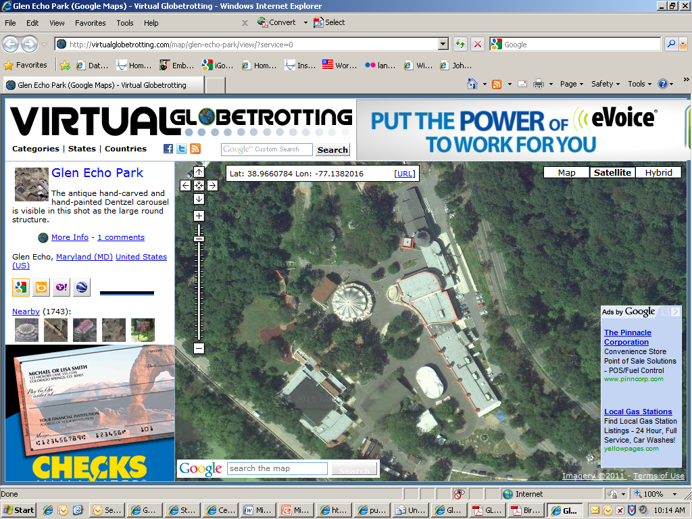
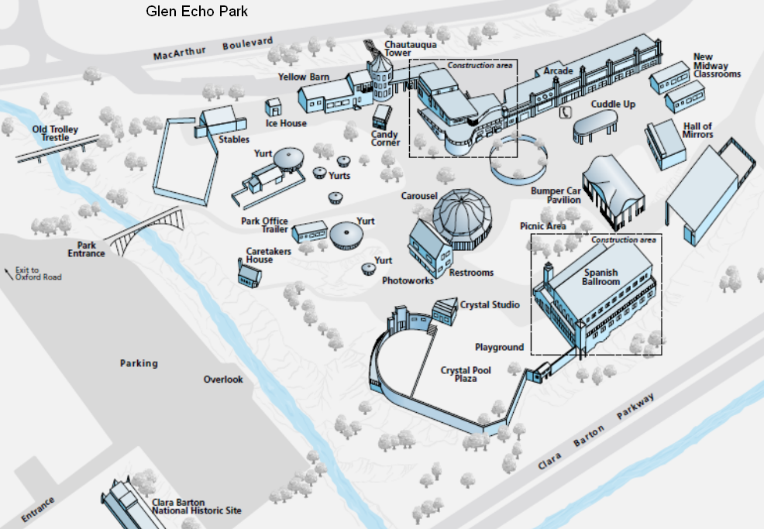
What is a Map?
A map is a image of a place, like a park. Sometimes a map shows the place from above. This is called a bird’s eye view.
Glen Echo Park is in Glen Echo, Maryland. The circular building is the carousel.
Notes:
Google Map image from http://virtualglobetrotting.com/map/glen-echo-park
Map of Glen Echo Park courtesy of the National Park Service http://www.nps.gov/hfc/cfm/carto-detail.cfm?Alpha=GLEC#

Slide 4
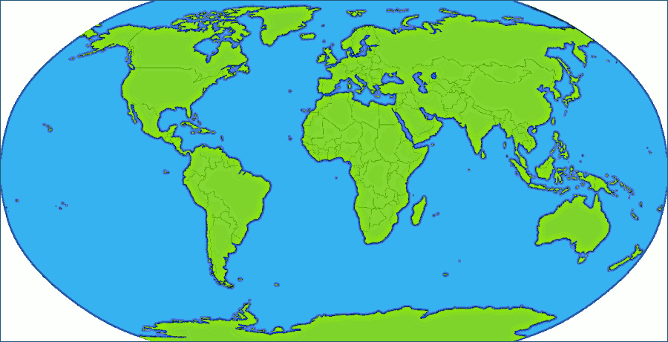
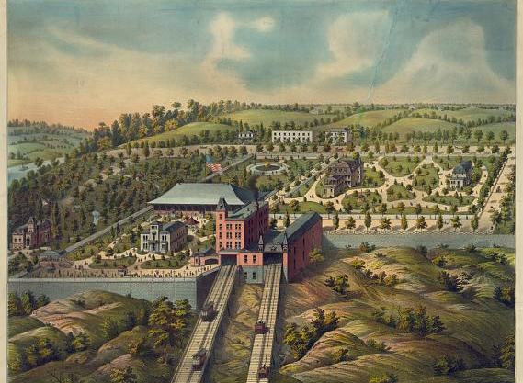
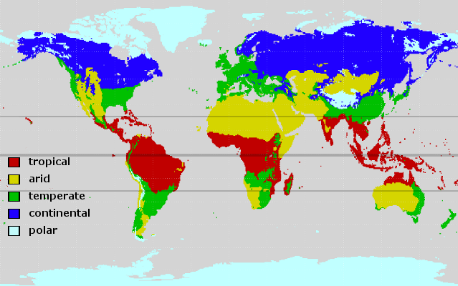
Using a Map
There are many different purposes for using a map. Maps are used to help you find where something is located. A map can show you if you are near to or far away from something.
Some maps show the entire world. Some maps show you just a neighborhood.
Maps also give information about a place. Sometimes they tell about the climate. Some maps show the population of different places.
Notes:
World Maps from clker.com
Neighborhood map Title: Birds-eye view of Price Hill inclined planes. Cincinnati, O.
Date Created/Published: [no date recorded on shelflist card]
Medium: 1 print.
Reproduction Number: LC-DIG-pga-02798 (digital file from original print)
Rights Advisory: No known restrictions on publication.
Call Number: PGA - Strobridge--Birds-eye view... (D size) [P&P]
Repository: Library of Congress Prints and Photographs Division Washington, D.C. 20540 USA

Slide 5
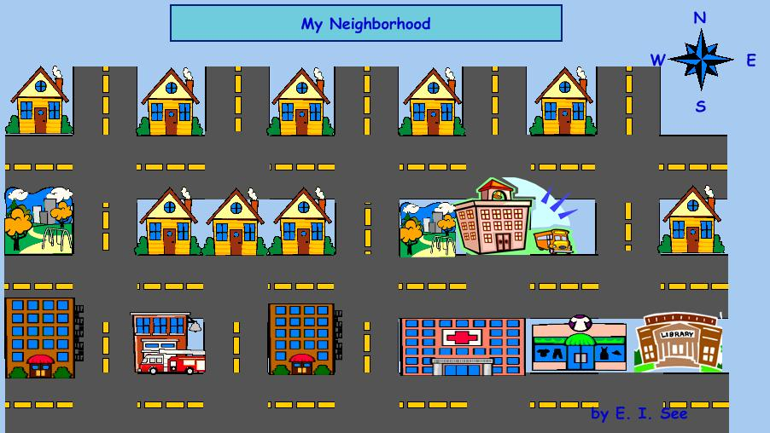
Map of a Community
This map of a community shows where people work and live. The compass rose points to the cardinal directions: north, east, south, and west. You can use a compass rose to help you find a place on the map. The hospital is south of the school. The fire station is west of the library.
compass rose
Notes:
Map created using Kidspiration software

Slide 6
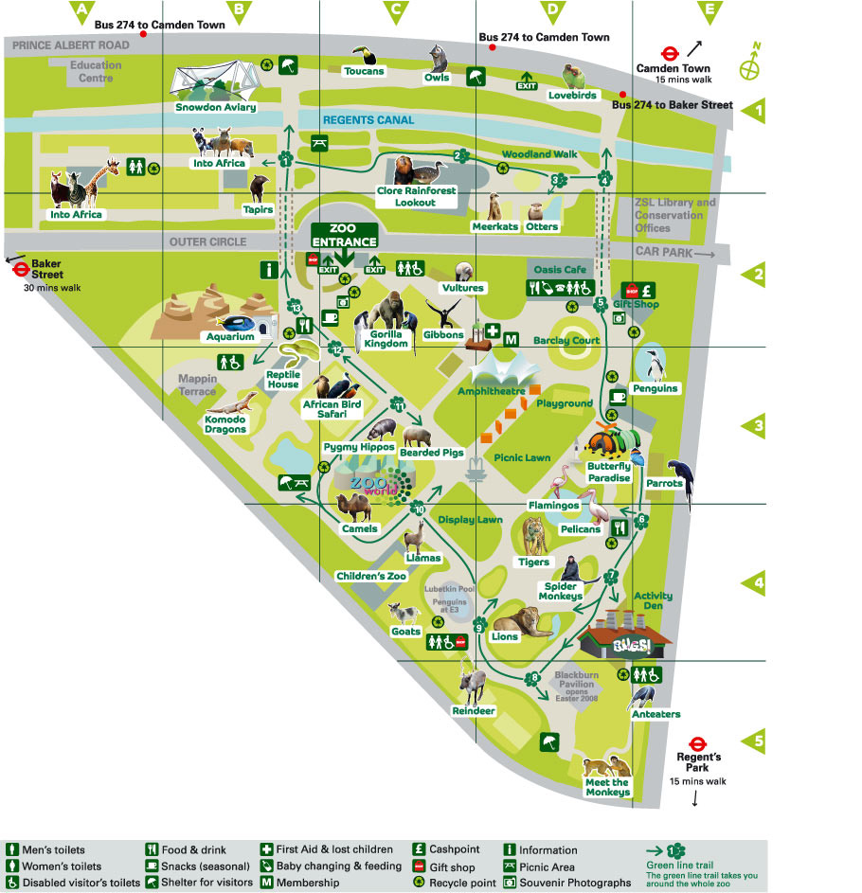
Understanding a Map
London Zoo
Maps often have images of objects. These images are symbols representing something that is real. A legend helps you understand what each symbol means. A legend is also sometimes called a key.
What is the purpose of this map? A map of a zoo can be used to help you find your way to your favorite animal. Different maps have different purposes.
Legend
Notes:
Map of London Zoo http://www.weblo.com/property/Other/London_Zoo/403899/

Slide 7
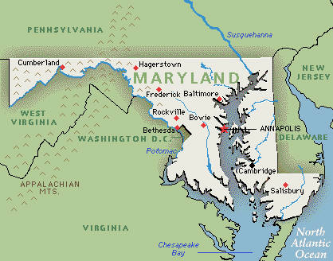
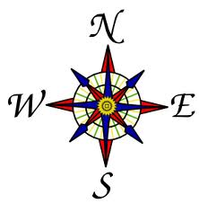
Map of a State
This is a map of Maryland. Maryland is a state in the United States of America. Using the map, you can see that Maryland is near the Atlantic Ocean and that Pennsylvania is north of Maryland.

Slide 8
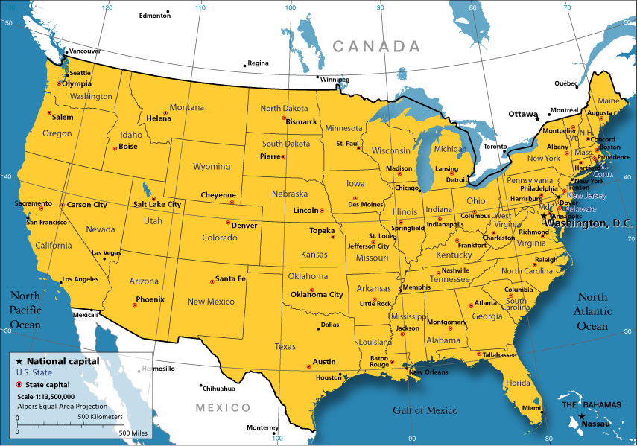

Map of a Country
This is a map of the United States. The United States is a country. You can find the symbol for a state capital on the legend. You can then use the symbol to help you find a state capital on the map.
U.S. State Capitals
A map of state capitols helps you learn the capital cities of all of the states.
Notes:
United States map from www.nationsonline.org http://www.nationsonline.org/oneworld/usa_map_small.htm

Slide 9
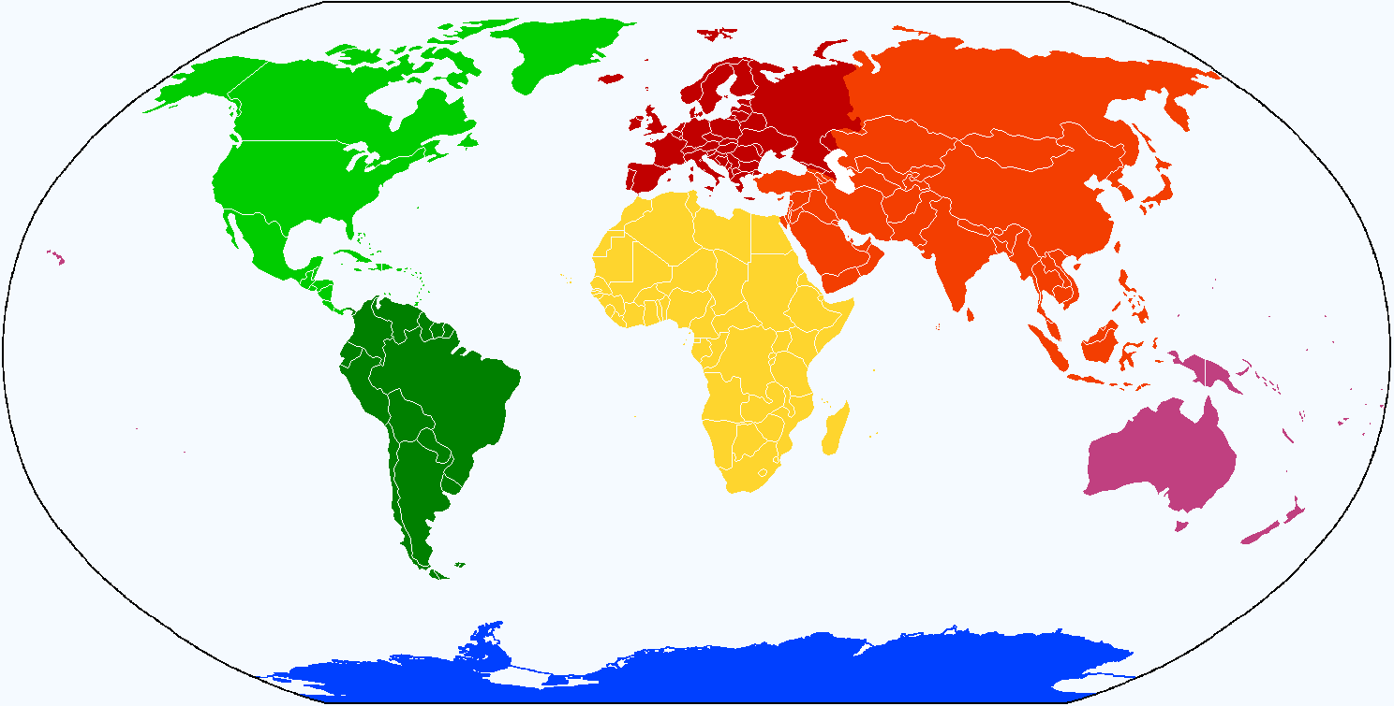

Map of the World
A map of the world shows continents and oceans. There are 7 continents and 5 oceans. Continents are the large land masses and each continent is represented by a different color on this map.
Arctic Ocean
Europe
North
America
Asia
Atlantic
Ocean
Pacific
Ocean
Africa
Pacific
Ocean
South America
Indian
Ocean
Australia
Southern Ocean
Antarctica
Notes:
www.nationsonline.org

Slide 10
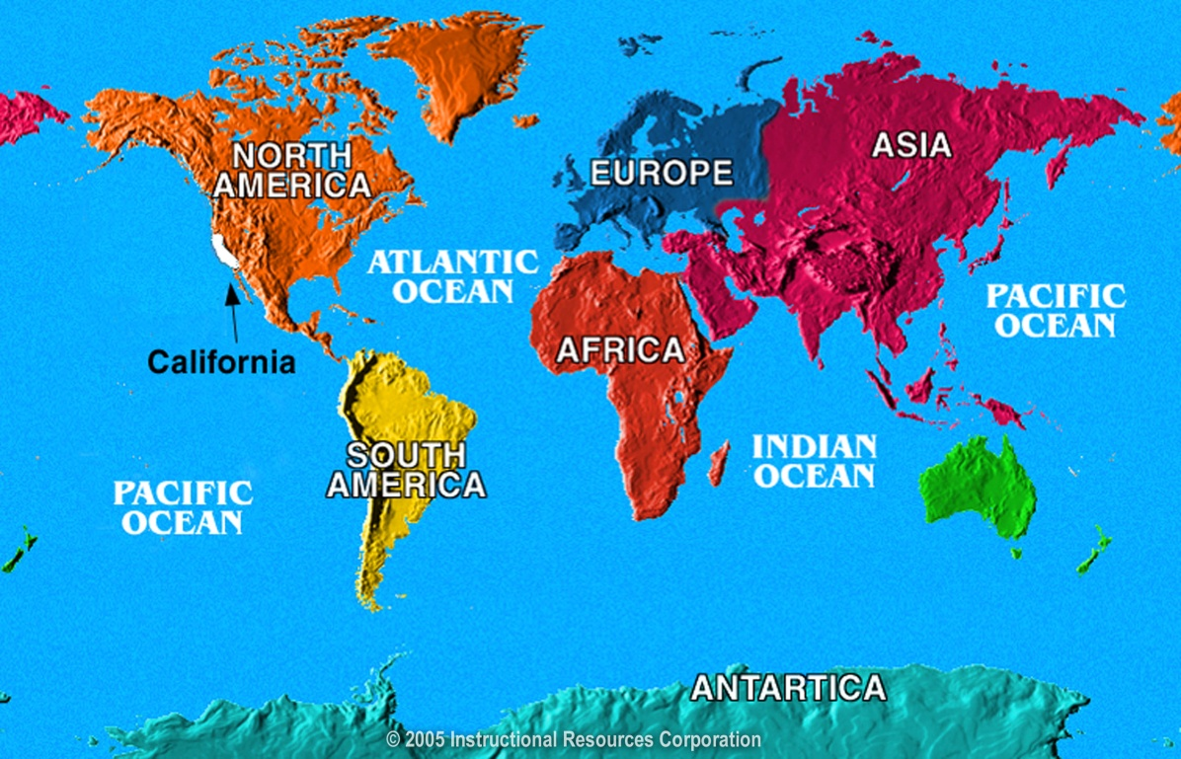
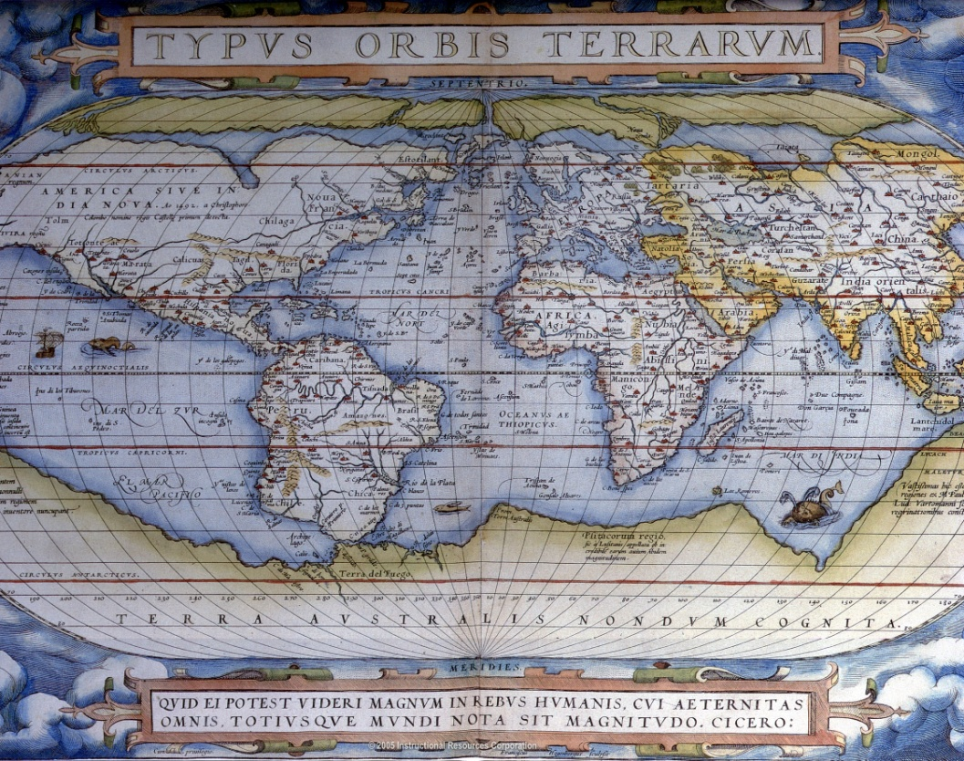
Maps From Now and Long Ago
This is a map of the world that was created in 2005.
This is a map of the world that was created in 1570.
It might be important to know when a map was made. What people know about the way the earth looks today is different than long ago, and this changes how our maps look.

Slide 11

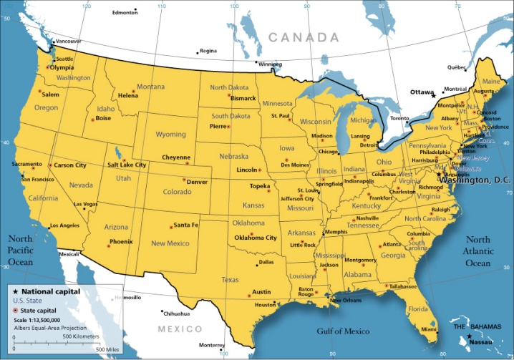
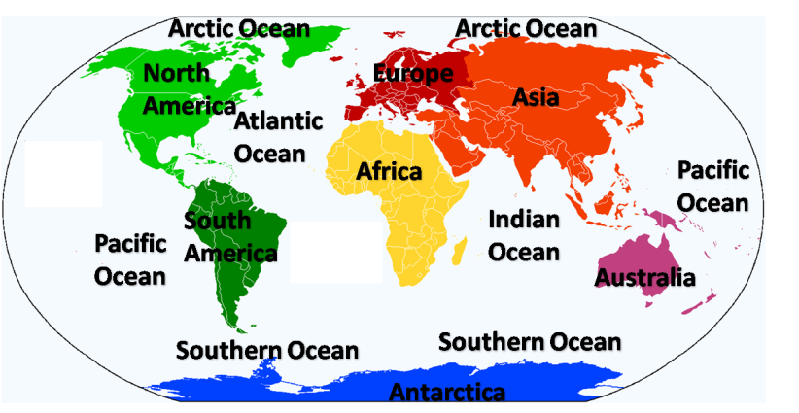
Choosing a Map
Katie and her teacher are looking at a map. They need plan their route from their school to the park for a field trip. What type of map do you think they are viewing?
U.S. State Capitals

Slide 12
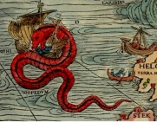
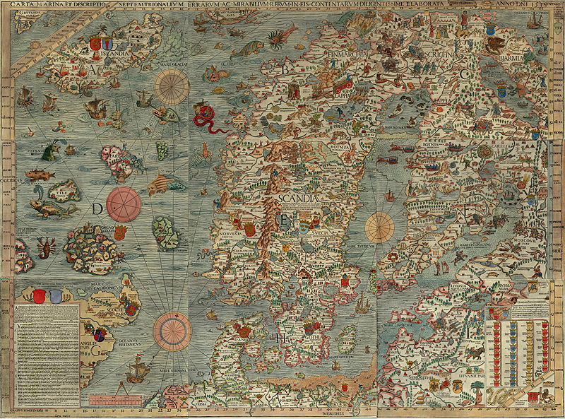
Choosing the Right Map
Good thing Katie and her teacher were not looking at this map! They would not want to run into that sea monster at the park!
This is the Carta Marina map. It is over 500 years old.

Slide 13
Glossary
bird’s eye view--seen from high above
compass rose--the set of arrows that show where north, south, east, and west are on a map or globe
continent--the great divisions of land of the Earth (North America, South America, Europe, Asia, Africa, Australia, or Antarctica)
country--an area of land that is controlled by its own government, the land of a person’s birth or citizenship
cardinal directions—north, south, east, and west
key or legend--explains the meaning of the symbols on the map
map--a model of the earth or a part of the earth that is drawn on a flat
  surface.
oceans--the salt water that covers much of the Earth's surface (Atlantic Ocean, Pacific Ocean, Arctic Ocean, Indian Ocean, Southern Ocean)
route--a way to get from one place to another
state--an organized political community living under the same government occupying a specific region
state capital--a city within a state where the main offices of government are located
symbols--the pictures, shapes, or colors on a map that stand for
  objects, places, or people

Slide 14
Index
bird’s eye view p.3, 13
compass rose p.5, 13
continent p.9, 13
country p.8, 13
cardinal directions p.5, 13
key or legend p.6, 13
oceans p.9, 13
route p.11, 13
state p. 7, 13
state capital p. 8, 13
symbols p. 6, 9, 13

